Slide 1
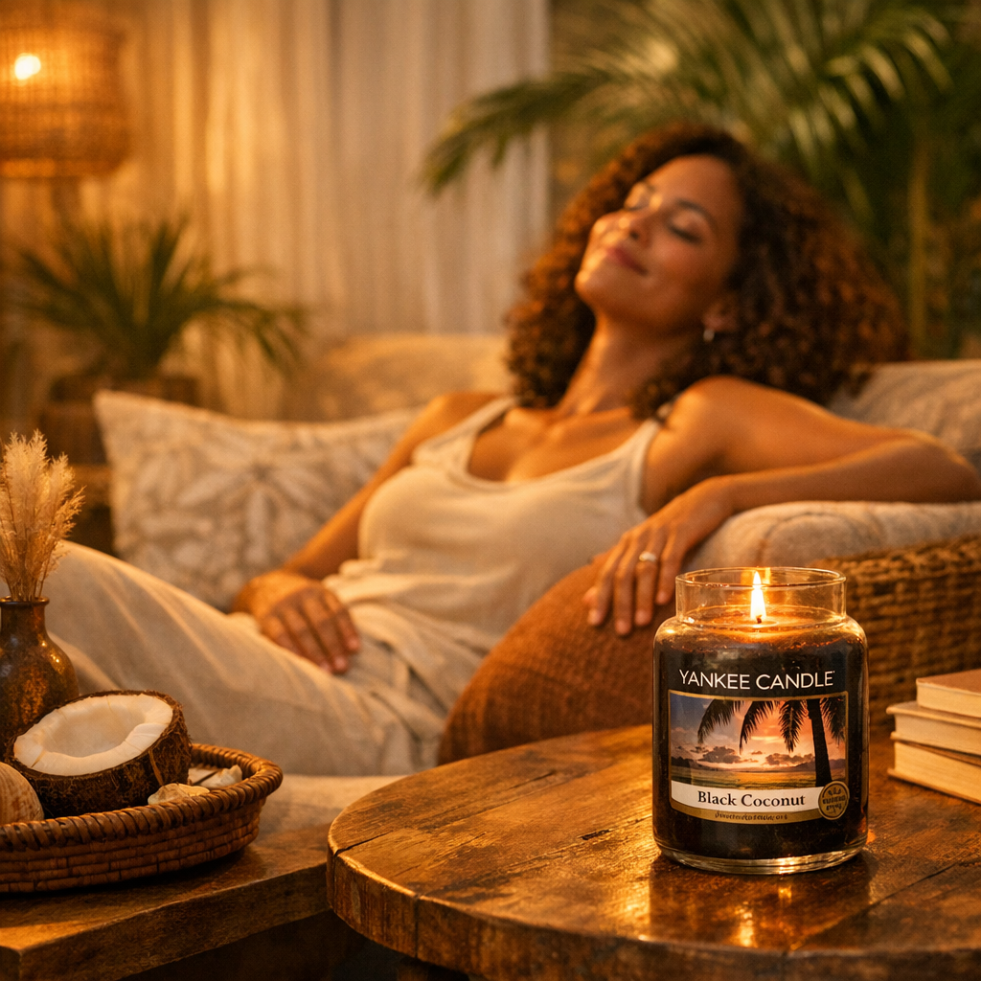
Instagram Marketing Strategy
Scented Candle Audience

Slide 2
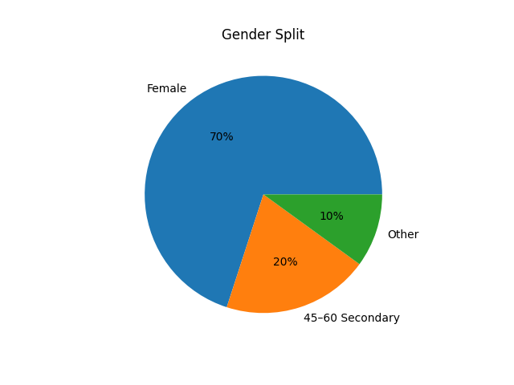
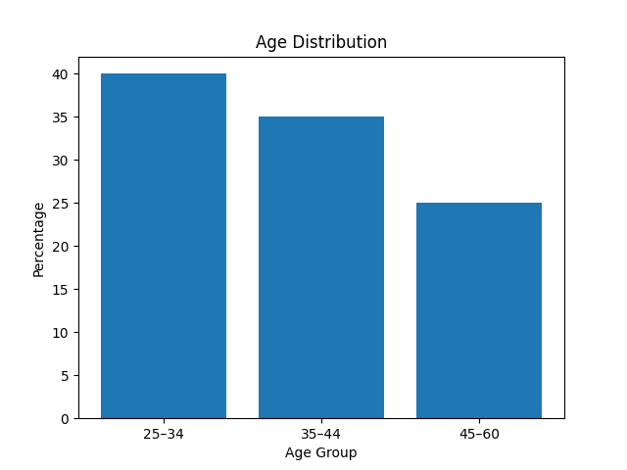
Demographics – Who They Are
Audience Profile
Age 25–44 primary (45–60 secondary)
Predominantly female
Urban & suburban UK
Middle income professionals
University educated
Young professionals, couples, mothers

Slide 3
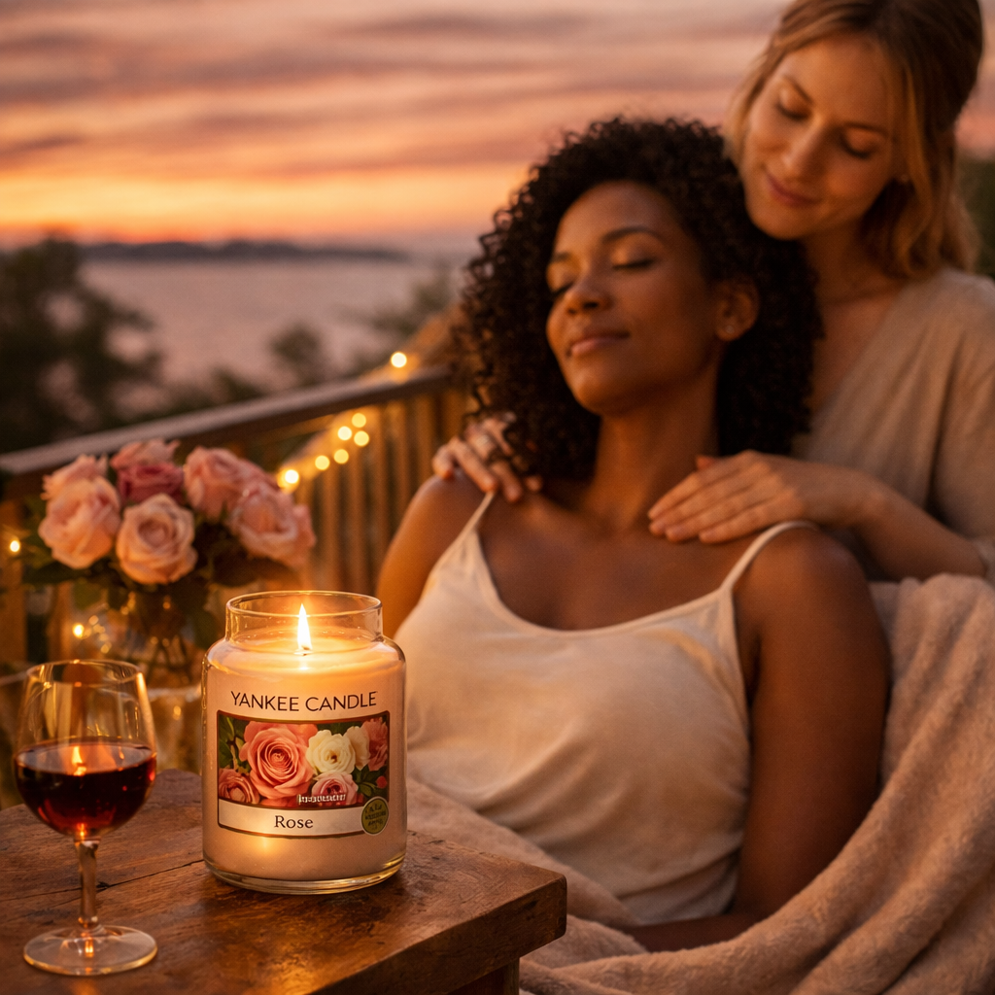
Psychographics – How They Think & Live
Mindset & Behaviour
Value calm & balance
Self-care is essential
Create welcoming homes
Host gatherings & brunch
Emotion-driven buyers
Influenced by Instagram aesthetics

Slide 4
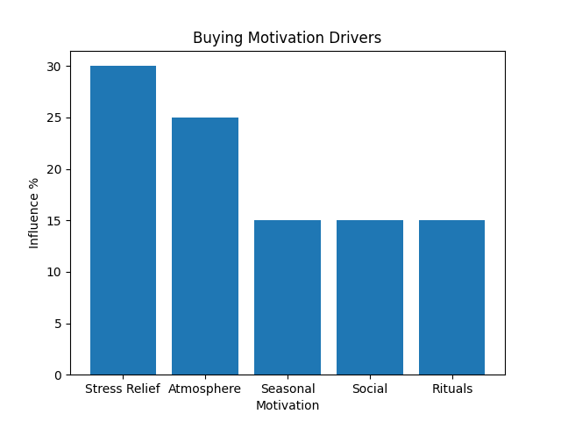
Buying Motivation

Slide 5
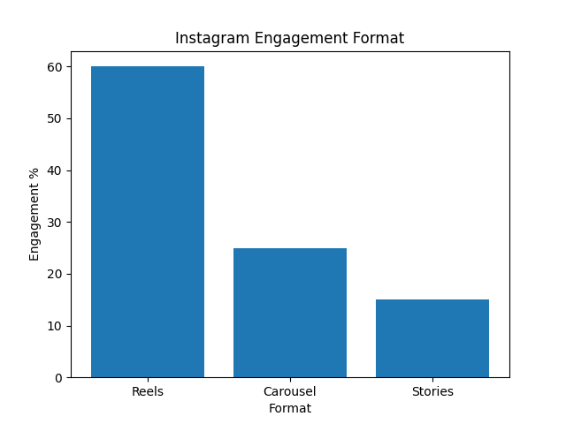
Instagram Behaviour Patterns

Slide 6
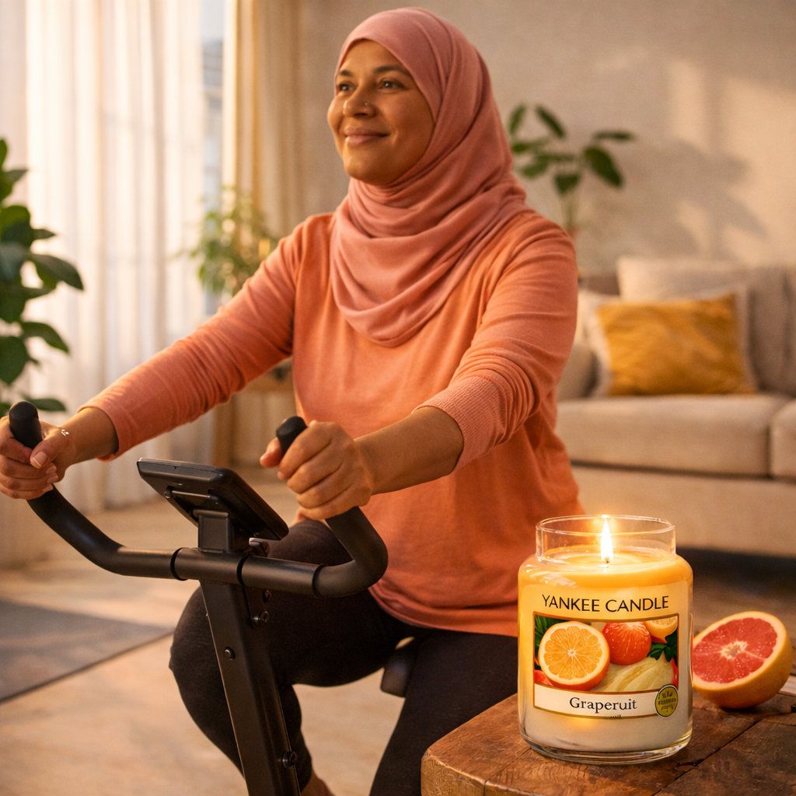
Content Strategy
Core Content Themes
Pause Moments (Stress → Calm)
Different Scents = Different Moods
Daytime Candle Use
Social Gathering Atmosphere

